Slide 1
Li7200 Obsolescence
Li7200 vs Li7200 RS

Slide 2
Background
The Li7200 is currently being phased out by the latest Licor model Li7200 RS.
Testing was conducted to verify:
Connectivity to the CI pipeline
If the Li7200 RS was comparable to the Li7200
If the Li7200 RS passed requirements?

Slide 3
Test Design
Li7200 and Li7200 RS were installed in parallel with their own closed path vacuum systems.
Test was broken out into two phases.
Phase 1: 2021-04-22 to 2021-05-01
Phase 2: 2021-05-07 to 2021-05-16
After SAE had 7 days of quality data the Li7200s were switched such that if there were any sampling biases introduced by the different closed path vacuum systems, they would be visible in the data.

Slide 4
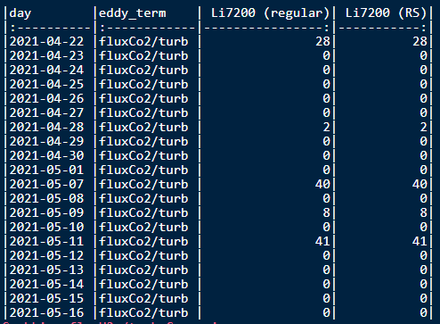
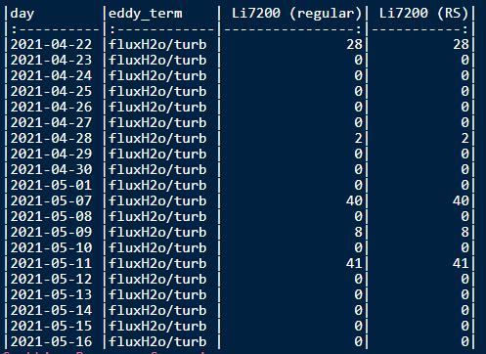
QFQM
Many flags were raised on several days and are highlighted in the final plots
Flagged data comes out as NaN so removing that day’s data did not heavily impact the statistics/plots

Slide 5
Executive Summary
Short discussion about the results and statistics

Slide 6
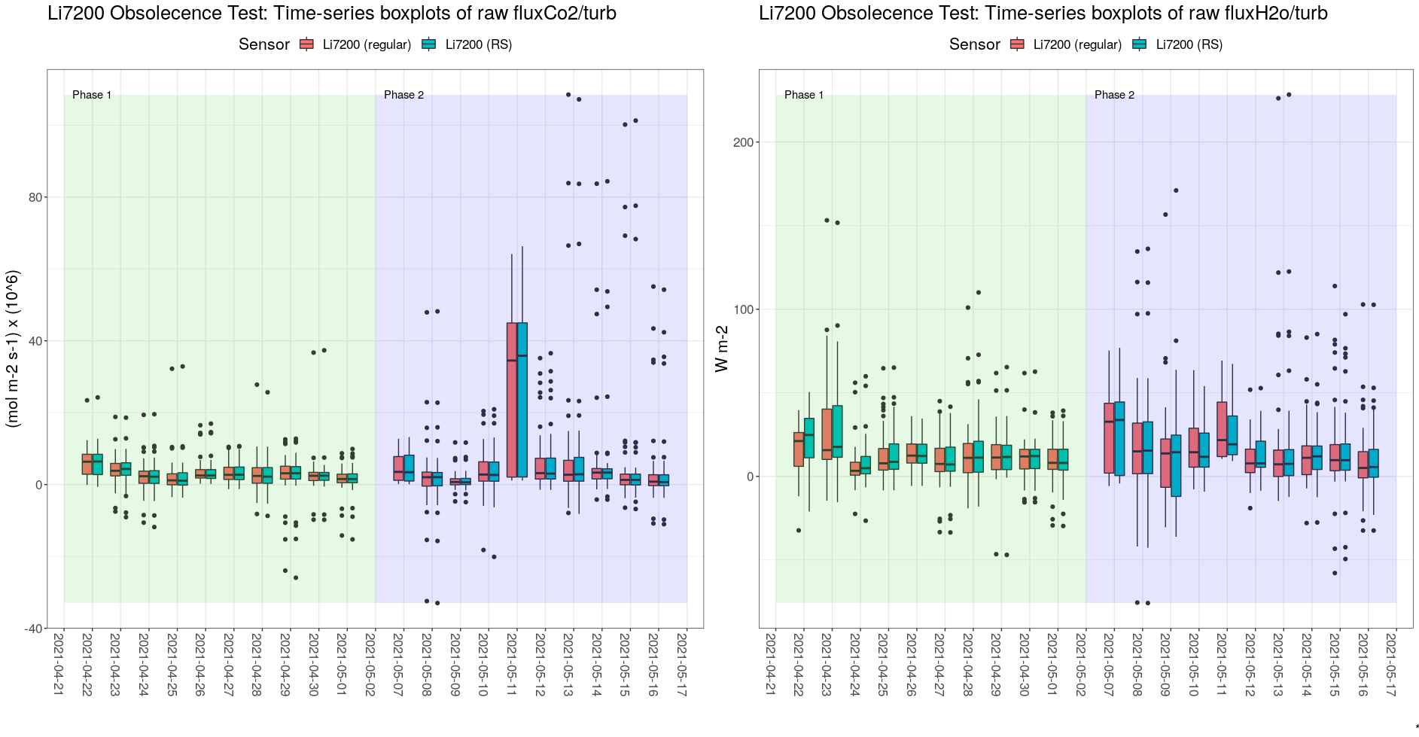
Executive Summary (cont.)
CO2 Fluxes
H2O Fluxes

Slide 7
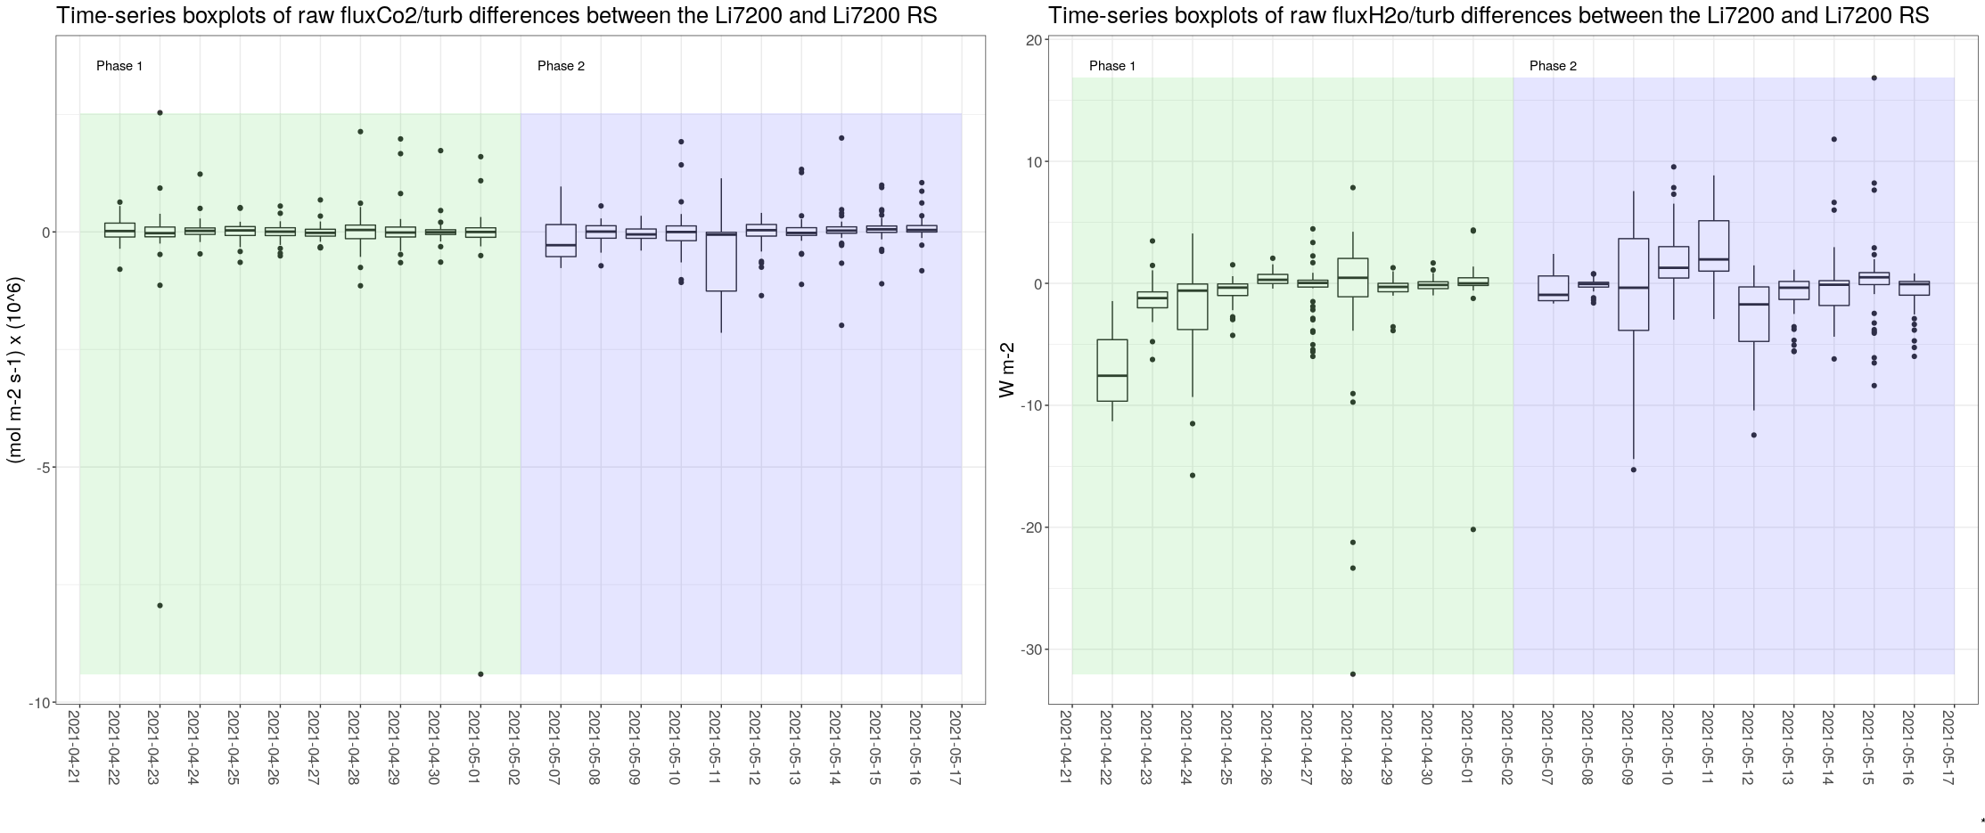
Executive Summary (cont.)
CO2 Fluxes
H2O Fluxes
CO2 Fluxes
H2O Fluxes

Slide 8
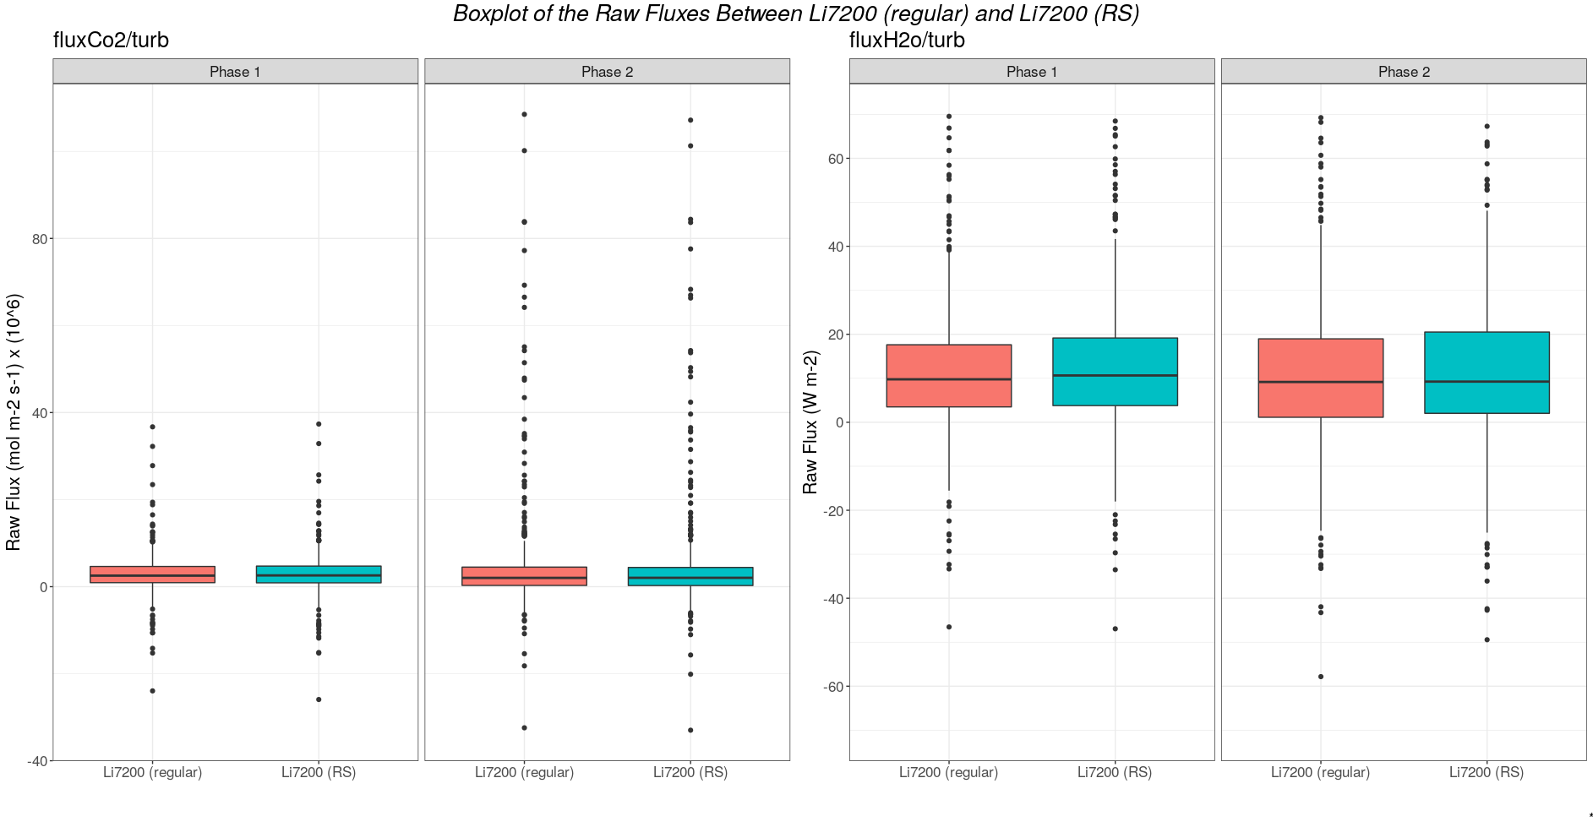
Executive Summary (cont.)

Slide 9
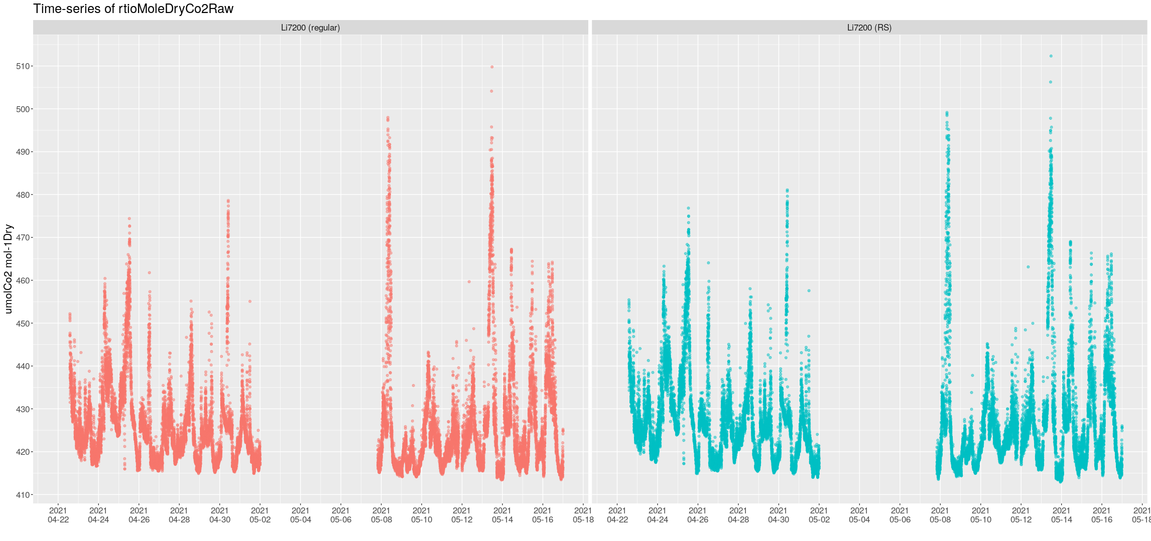
Additional Plots – CO2 1-min – Raw Values

Slide 10
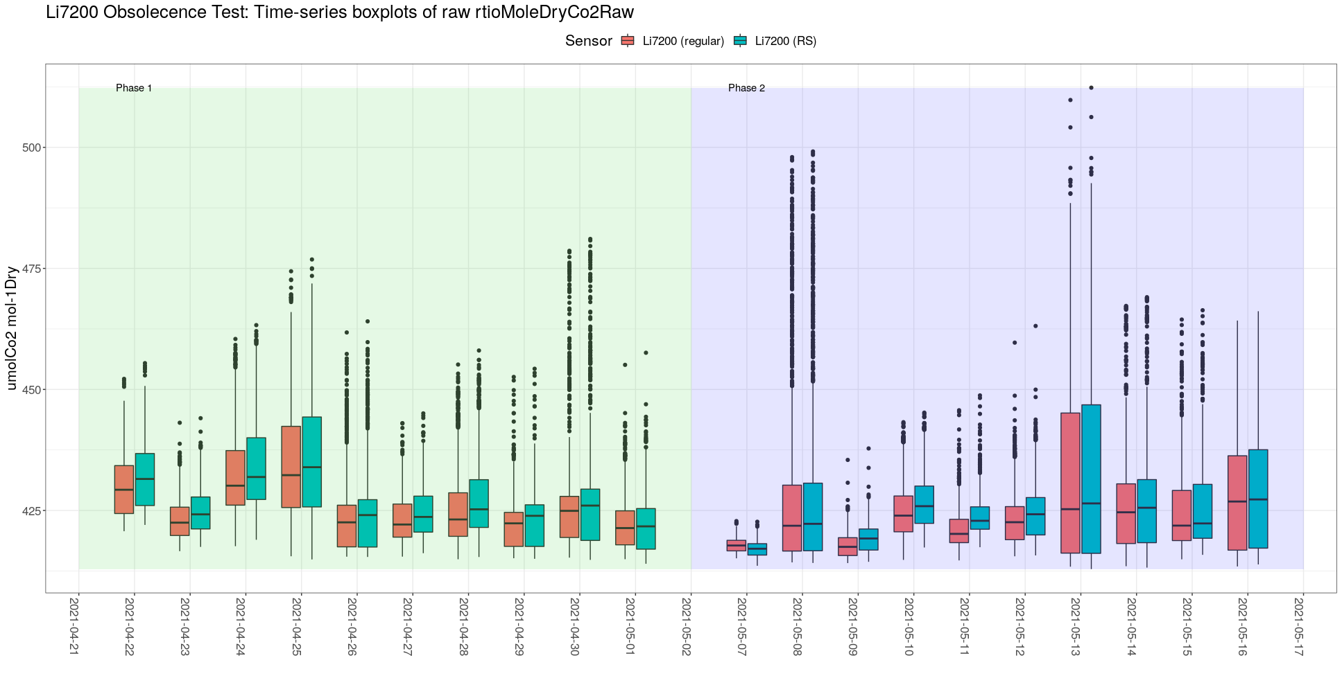
Additional Plots – CO2 1-min – Daily Box Plot

Slide 11
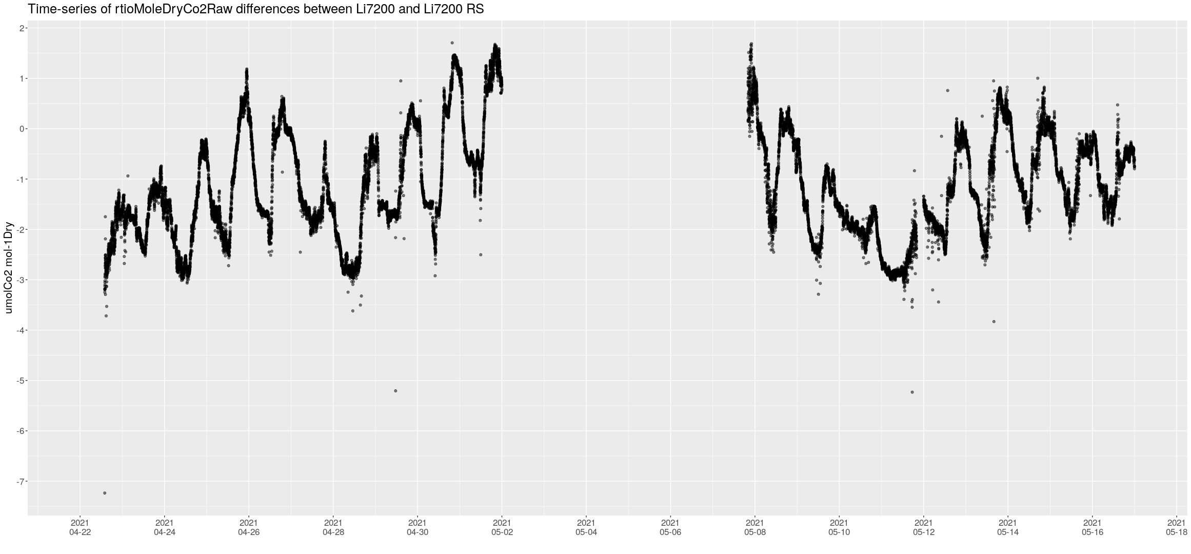
Additional Plots – CO2 1-min – Difference

Slide 12
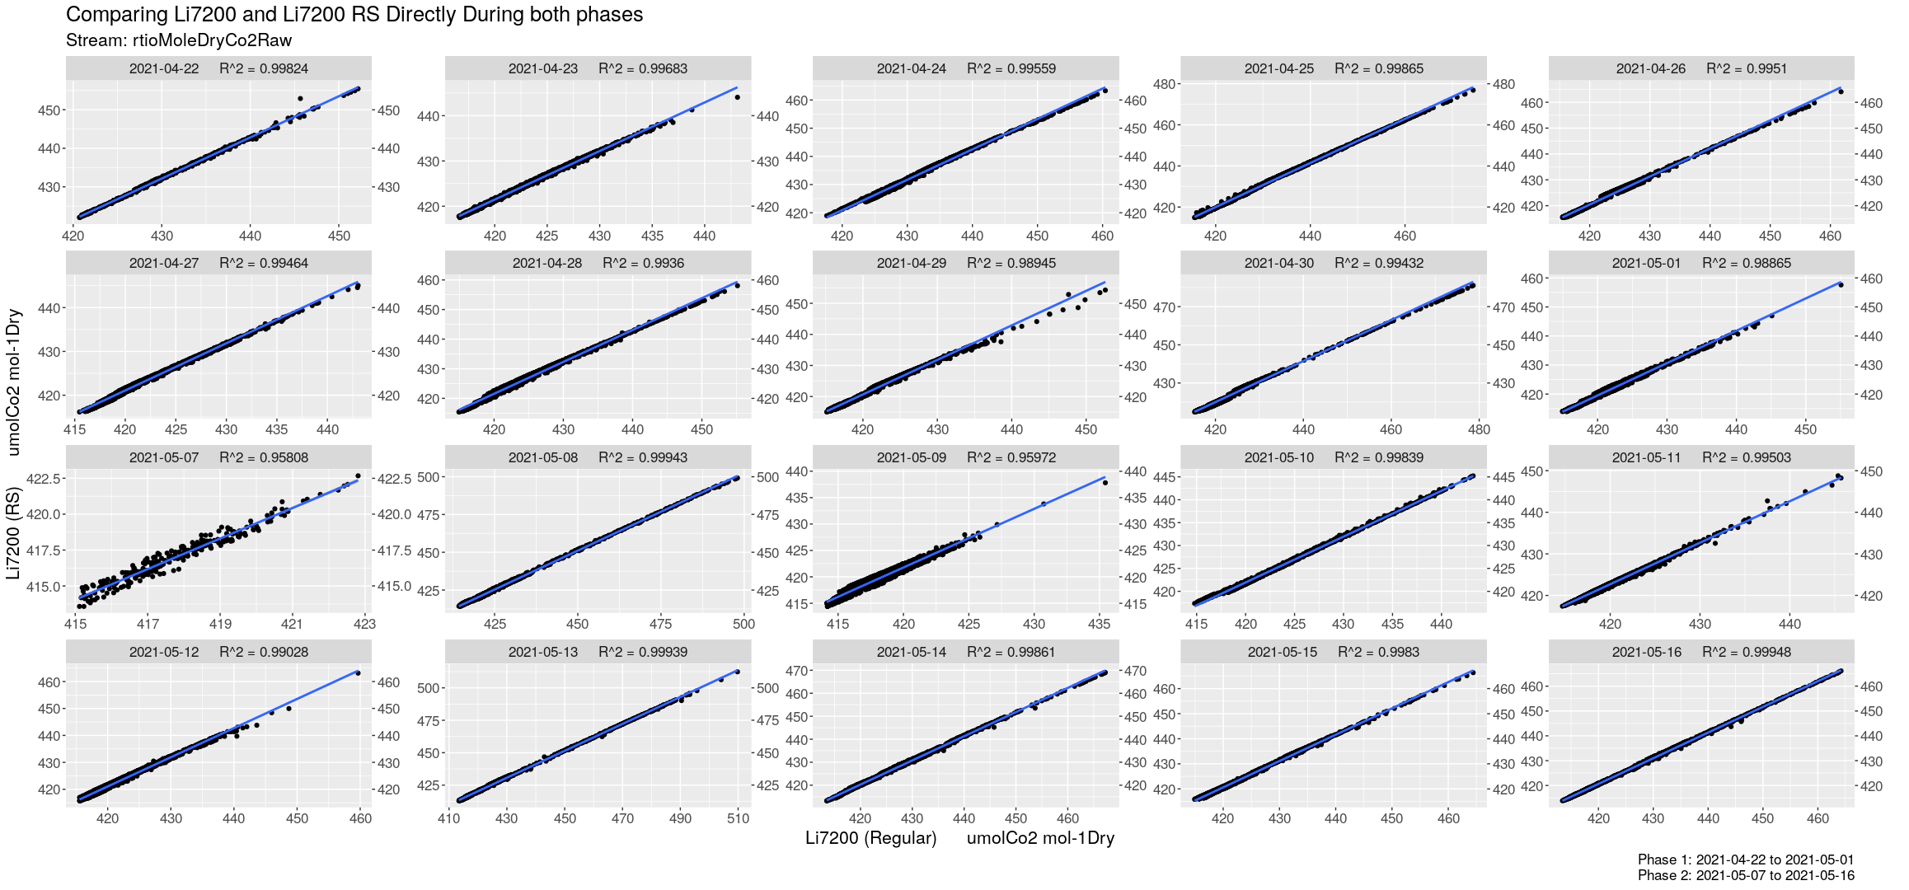
Additional Plots – CO2 1-min – Li7200 ~ Li7200RS

Slide 13
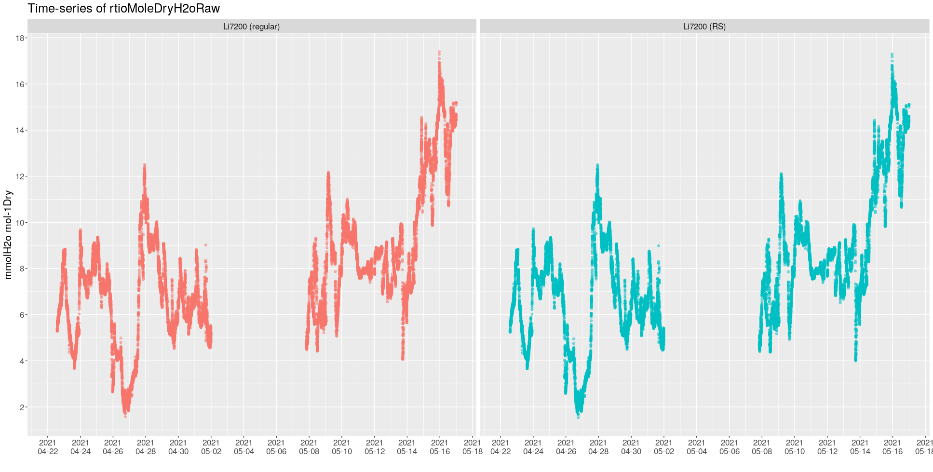
Additional Plots – H2O 1-min – Raw Values

Slide 14
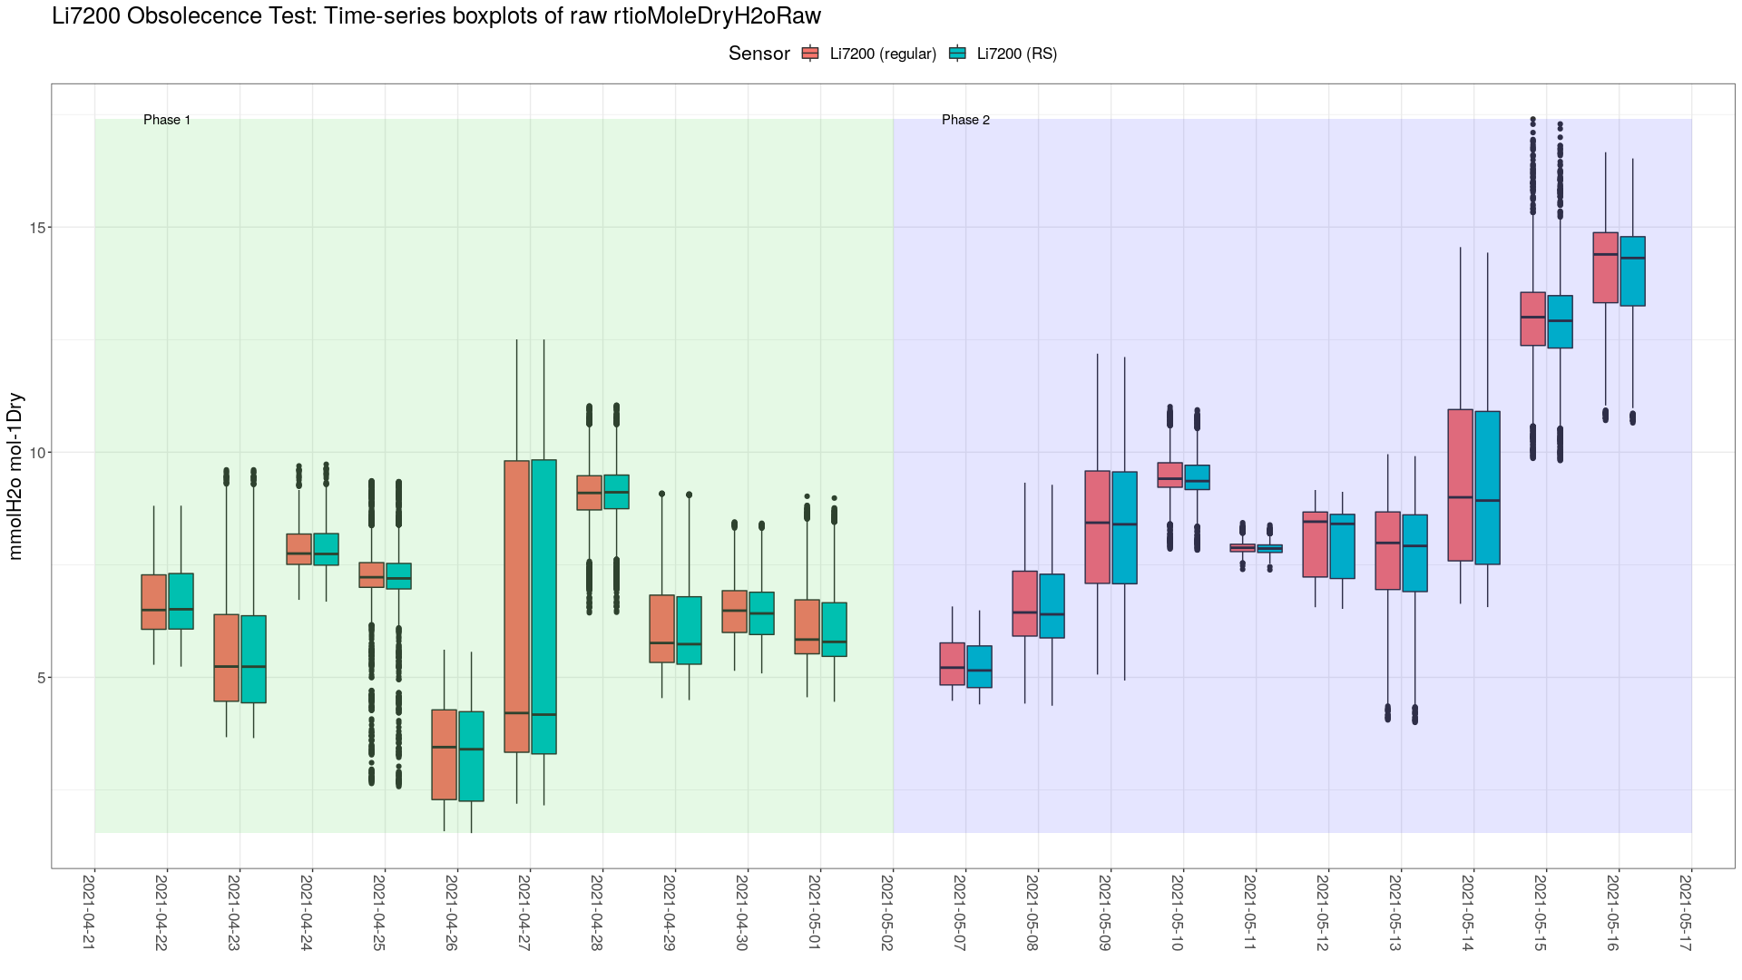
Additional Plots – H2O 1-min – Daily Box Plot

Slide 15
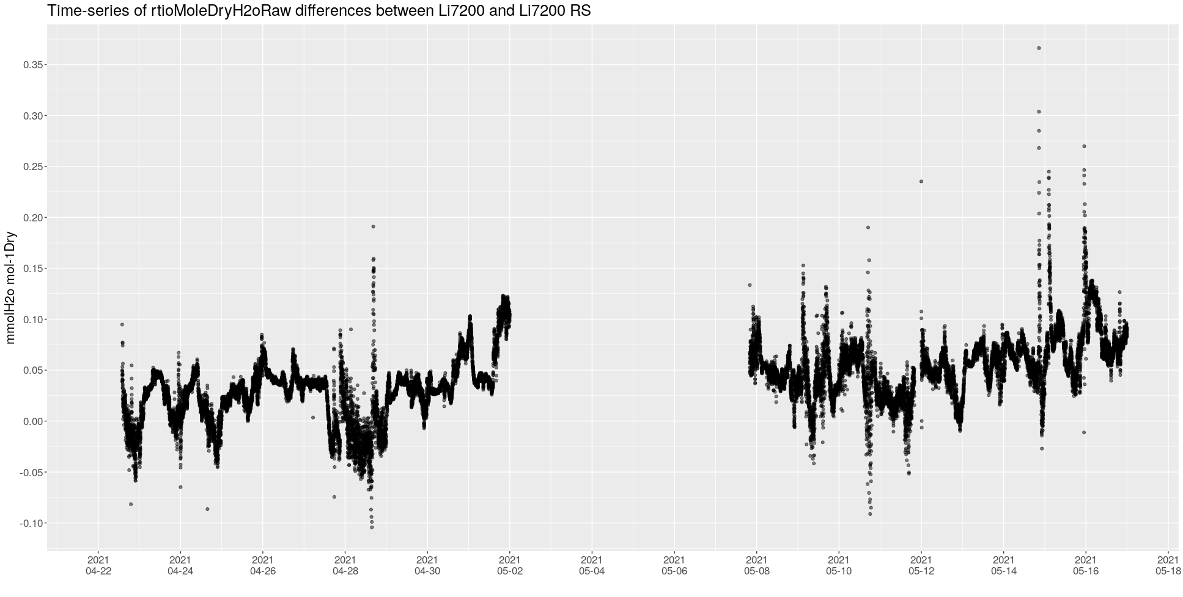
Additional Plots – H2O 1-min – Difference

Slide 16
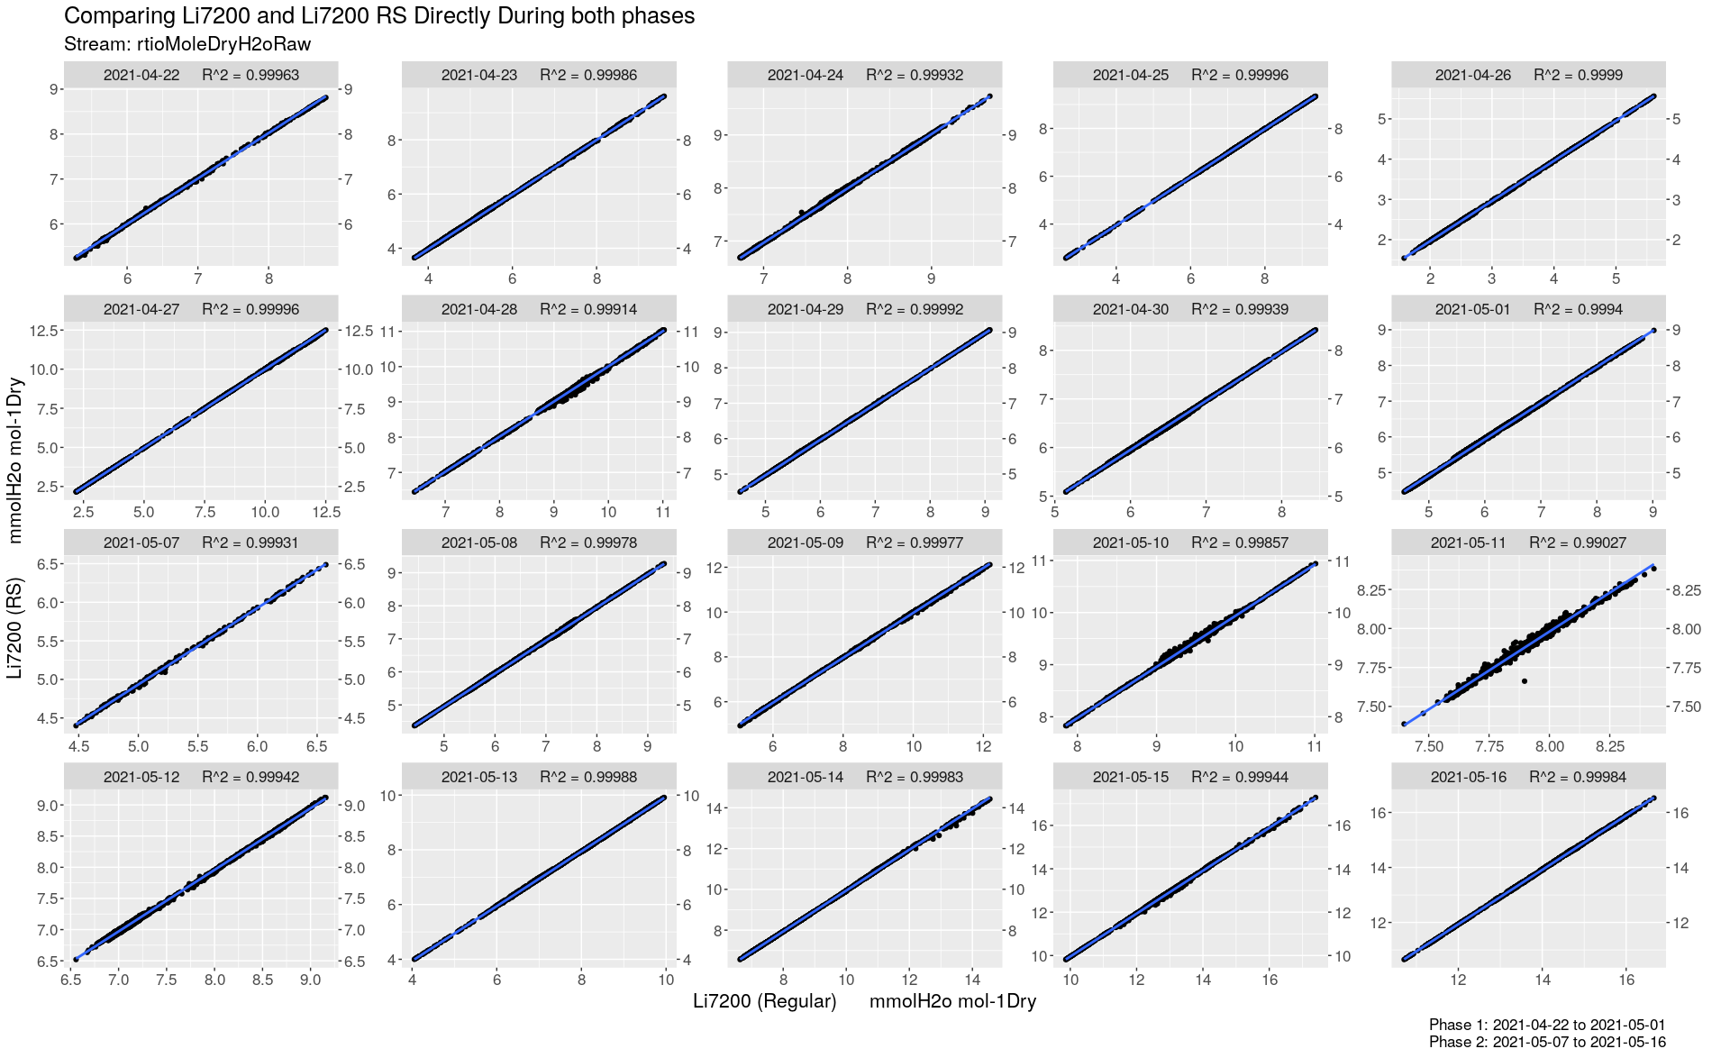
Additional Plots – H2O 1-min – Li7200 ~ Li7200RS

Slide 17
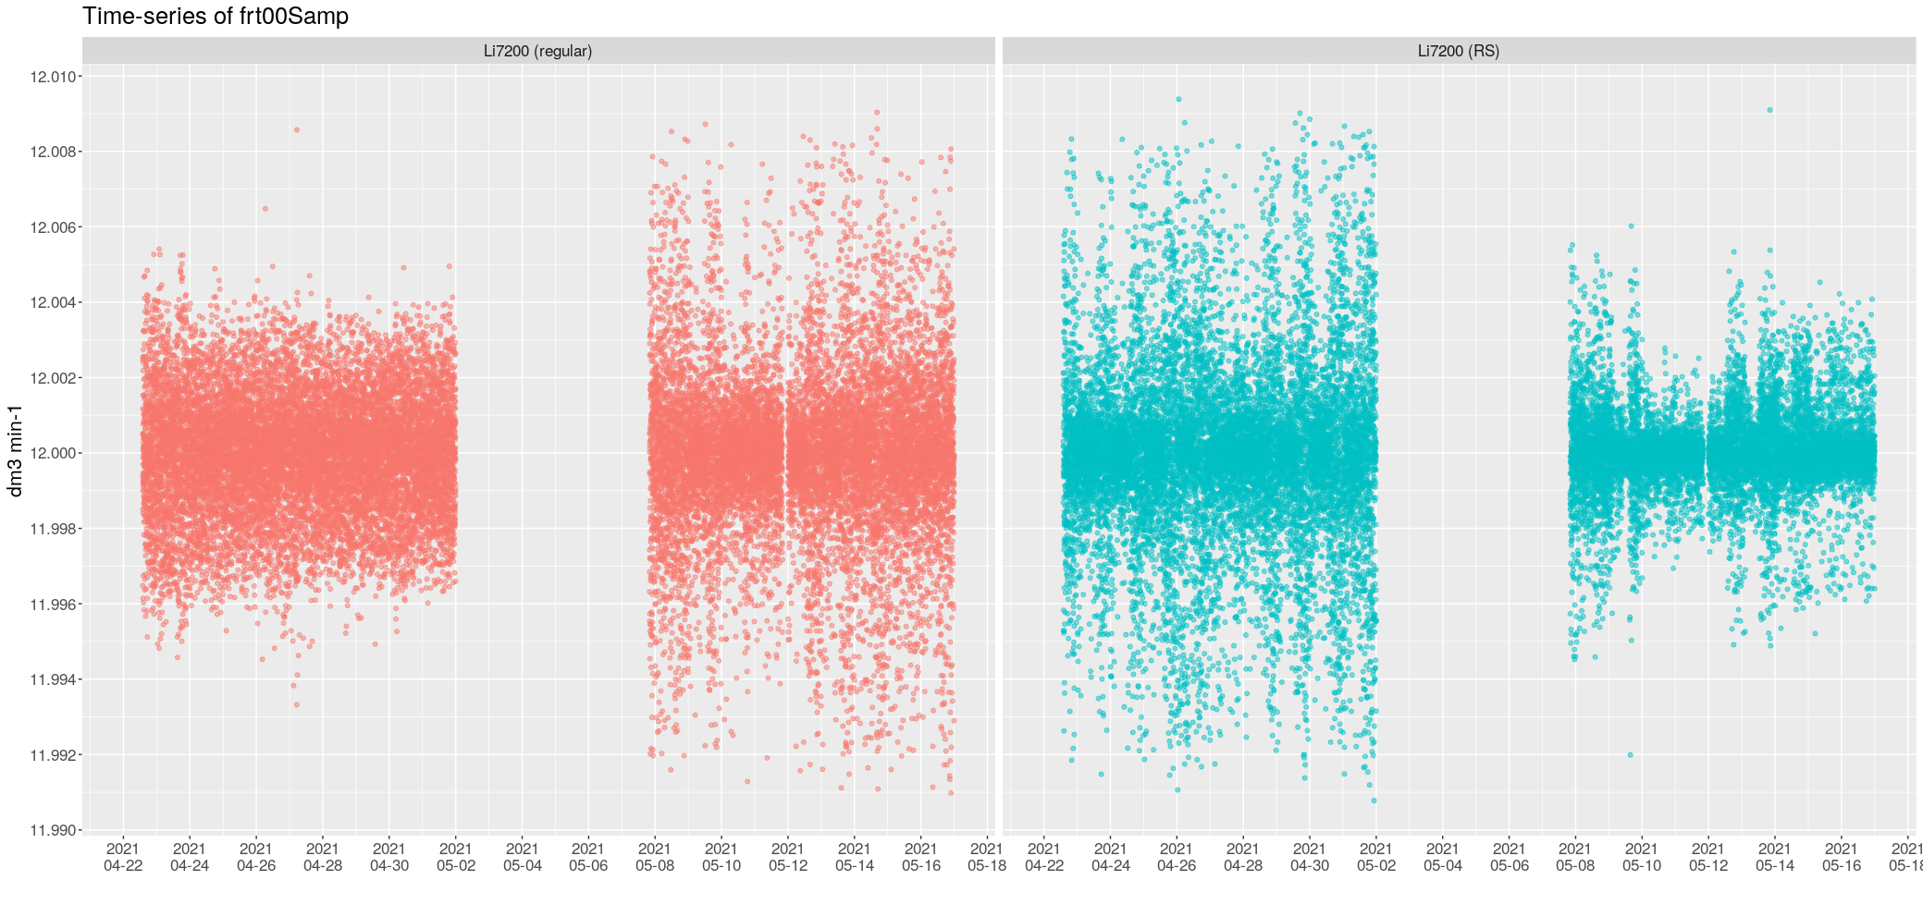
Additional Plots – frt00 1-min – Raw Values

Slide 18
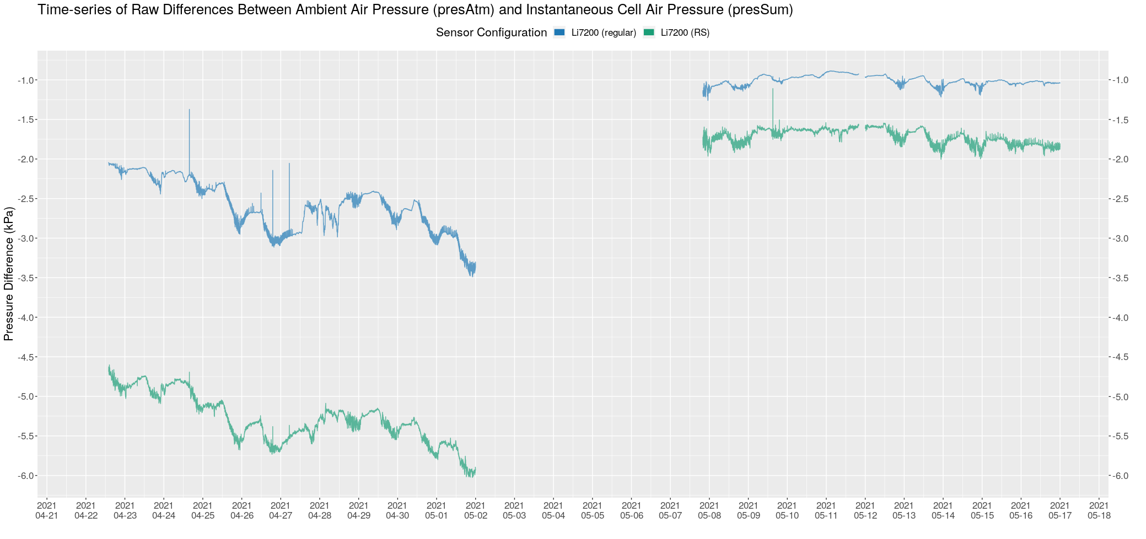
Additional Plots – pdiff 1-min – Raw Values

Slide 19
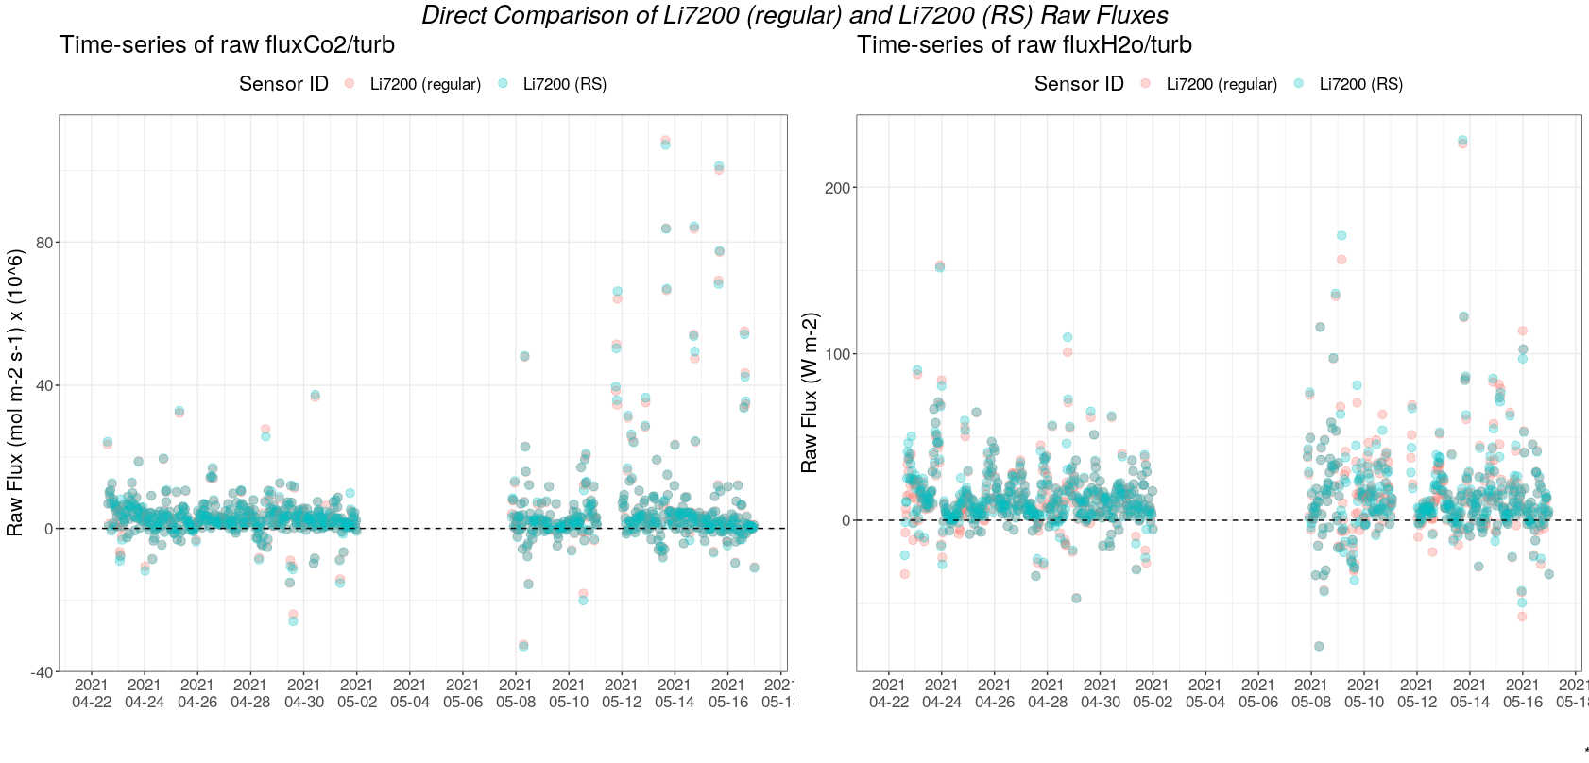
Results

